Slide 1
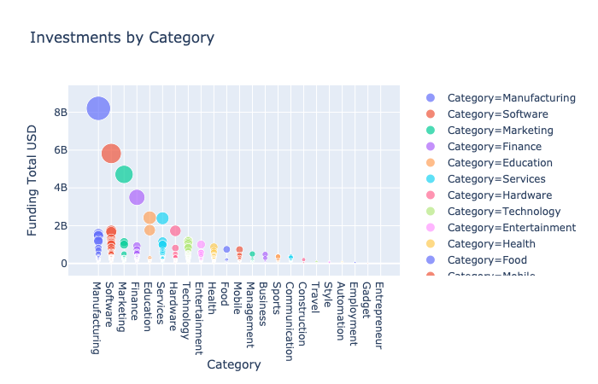
Investment by Category
We have observed that manufacturing, software, and marketing are the leading categories in total investments.

Slide 2
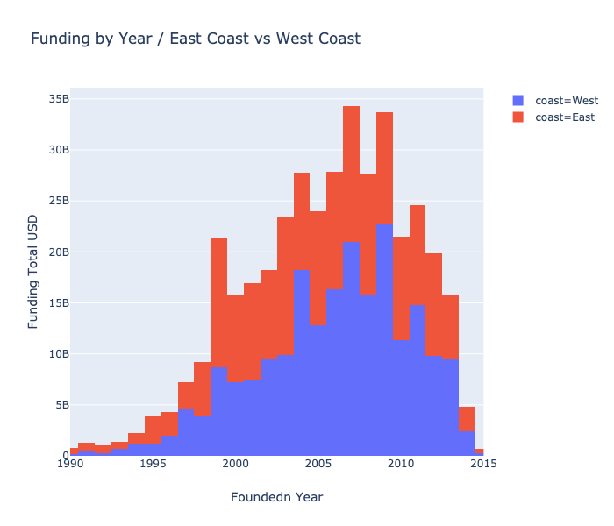
Funding by Year – East Coast vs. West Coast
We have observed that the east coast dominates throughout the years, with more funding into its companies.

